Slide 1
City of Independence
2025 Final Budget
December 3, 2024

Slide 2
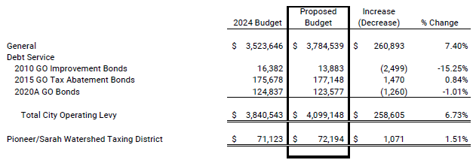
2025 Levy Compared to 2024

Slide 3
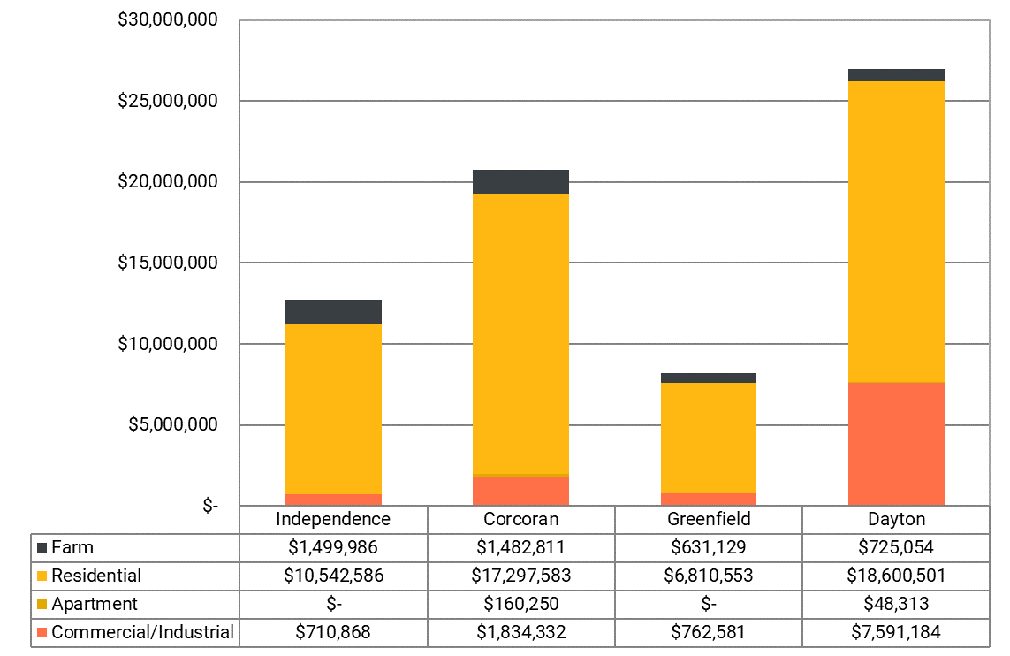
Tax Capacity Graphs

Slide 4
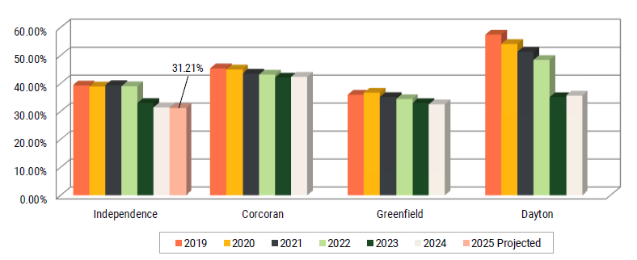
Tax Capacity Rate Graphs

Slide 5
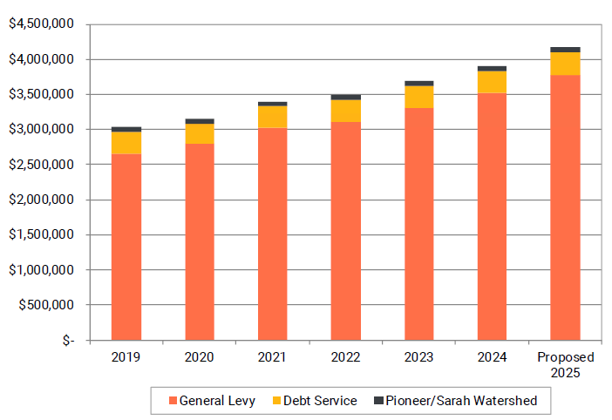
Levy Summary 2019 to 2025 Projected

Slide 6
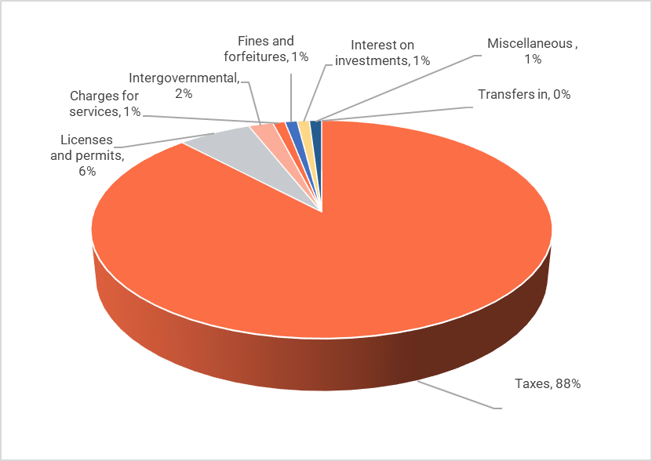
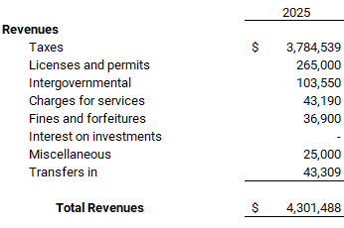
2025 Projected General Fund Revenue

Slide 7
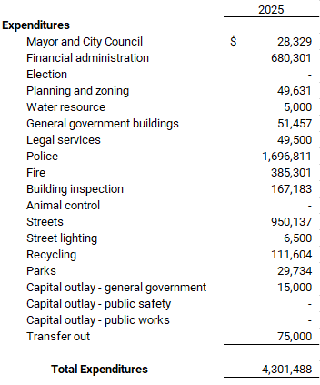
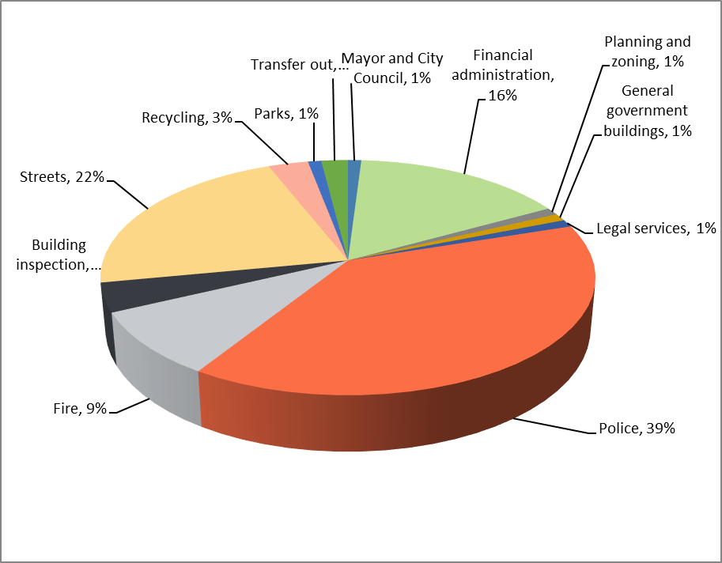
2025 Projected General Fund Expenditures

Slide 8
The general fund tax levy increased $260,893 or 7.40% over prior year. The tax rate calculates to 31.21%. Prior year’s tax rate was 31.47%. Some factors in the change are described below.
Police protection increased $143,574 or 9.24% from the 2024 budget.
Fire services were decreased by $12,754 or 3.20% from the 2024 budget.
Streets increased by $219,185 or 29.99% due to additional funding received from the state.
Elections decreased by $8,532 or 100% due to no elections being held in 2025.
Building inspection increased by $15,780 or 10.42% due to increased hours budgeted.

Slide 9
Approve the levy and budget as presented and certify to the County

Slide 10
Questions?

